Slide 1
The X's and O's to a Quality Program
How to Meet the Benchmarks in
Today's Culture and Environment

Slide 2
Five Requirements
1.) Written policies and procedures
2.) Volunteer screening
3.) Coach training
4.) Parent education
5.) Accountability

Slide 3
Do you meet the benchmark?
A) Do written policies include a recreational focused philosophy statement?
B) Do written policies address athlete playing time?
C) Are written policies and procedures available to all parents, coaches and volunteers?
D) Are code of ethics/conduct pledges for coaches and parents required?
E) Do written procedures include action plans to address medical, weather and violence related emergencies?

Slide 4
How do you put
words into action?
What is the hardest part of this and how do we overcome it?

Slide 5
How are your written policies and procedures changing with COVID-19?
i.e. New policies, enforcement, communication, best practices

Slide 6
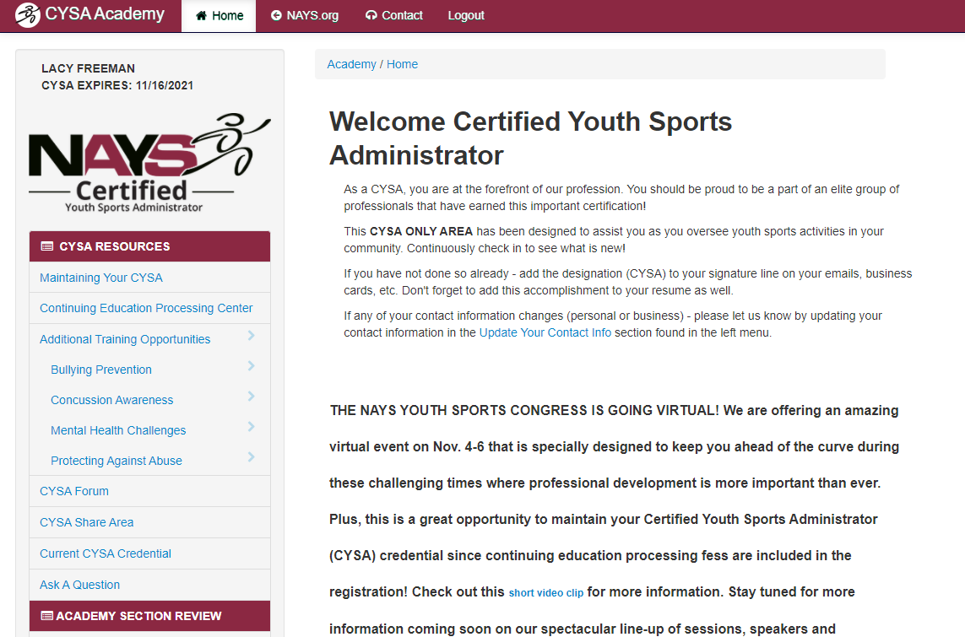
Resources
for CYSAs
Includes Re-Opening Plans
and Documents from Across
the U.S.!
#WINNING

Slide 7
CYSA Quarterly Forum
Next Forum: January 2021
Volunteer Screening
and More!

Slide 8
Sign Up Today!

